Slide 1
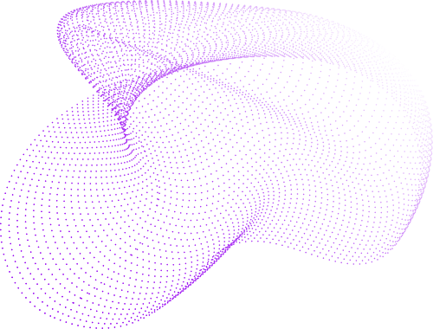
Stock Price Prediction Model
NTT Stock Price Forecasting using time series forecasting models

Slide 2
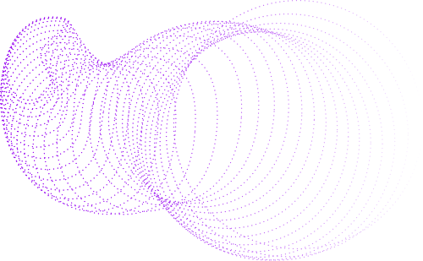
About Myself
Pranav, final-year CSE student at IIT Jodhpur with experience as a Data Scientist intern and researcher, working on AI, machine learning, and real-world applications.
Curious, analytical, and passionate about AI; skilled at solving complex problems and adapting quickly.
Team player with good communication skills, enjoying collaborative work and contributing to shared goals.
Fascinated by Japan’s work and culture, drawn to their focus on precision, dedication, and continuous improvement.

Slide 3
Background
Stock Price Prediction Importance:
Stock prices are influenced by various factors such as market trends, economic indicators, and company performance.
Accurate prediction models provide key insights for investors, allowing them to make informed decisions.
Challenges:
Time series forecasting involves handling noisy and non-stationary data.
The complexity of predicting future prices is compounded by factors like seasonality, volatility, and external influences.

Slide 4
Data Analysis Results (EDA)
Stock Price Analysis :
Stock Prices (¥)
Average Closing Price: ¥92.18
Minimum Closing Price: ¥33.00
Maximum Closing Price: ¥305.90
The data indicates a significant fluctuation in stock prices over the period.
Trading Volume:
Average Volume: 172.67 million shares
Standard Deviation: High, indicating variability in trading activity.
Trading activity shows significant day-to-day shifts.

Slide 5
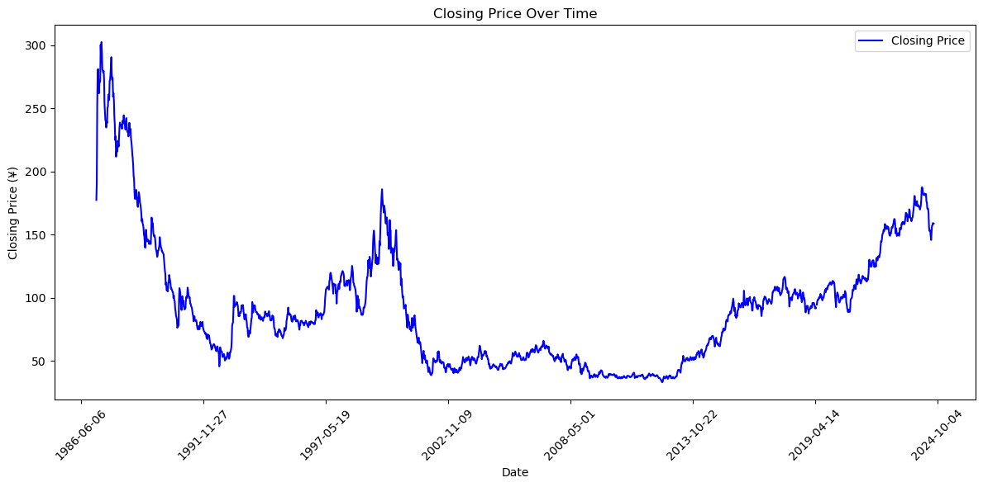
Data Analysis Results (EDA)
Closing price vs Date Plot
There is a big fluctuation in the stock prices over the timeframe.

Slide 6
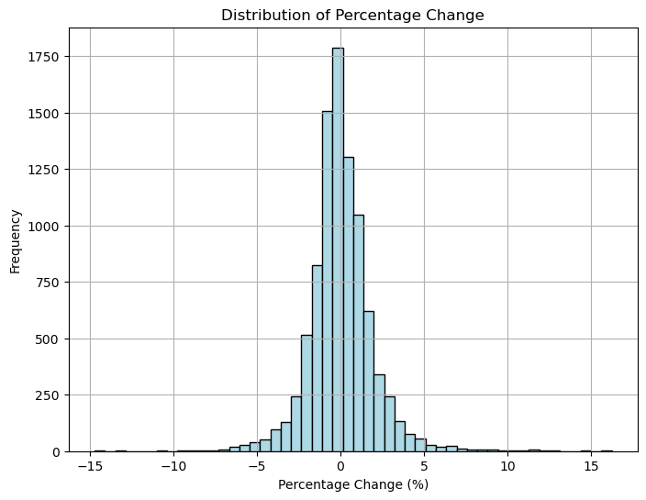
Data Analysis Results (EDA)
Daily Percentage Change
Average Change: 0.02%
Range: -14.74% to 16.25%
The wide range in daily percentage changes highlights notable market volatility.

Slide 7
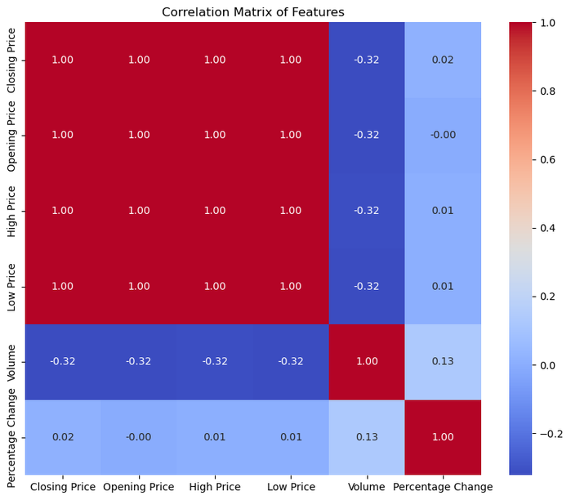
Data Analysis Results (EDA)
Correlation Matrix Analysis
Strong Positive Correlation (1.0) between Closing, Opening, High, and Low Prices, indicating they move together.
Moderate Negative Correlation (-0.32) between Volume and the prices.
Percentage Change has minimal correlation with other features, suggesting independent behavior.

Slide 8
Data Analysis Results (EDA)
ADF Test Results
ADF Statistic: -3.63
p-value: 0.0052
Interpretation:
ADF statistic is lower than all critical values and p-value < 0.05.
Null hypothesis is rejected.
Conclusion:
The data is stationary, suitable for ARIMA.

Slide 9
Preprocessing
Null values : Checked and remove rows with null values.
Created the following new features:
Moving Averages:
MA10: 10-day moving average of the Closing Price.
MA50: 50-day moving average of the Closing Price.
Lag Features:
Created lagged values of the Closing Price for the past 5 days (Lag_1 to Lag_5).
Volatility:
Calculated as the rolling standard deviation over a 10-day window.

Slide 10
Technical Overview
Models Used:
ARIMA: Selected for its ability to handle trends and seasonality in time series data.
LSTM (Long Short-Term Memory): Chosen for its capability to capture long-term dependencies in stock price data.
GRU (Gated Recurrent Unit): Similar to LSTM but computationally more efficient, allowing quicker training.
Data Preprocessing:
For the scaled dataset, MinMaxScaler was used to normalize stock prices between 0 and 1.
For the unscaled dataset, raw stock prices were used directly for modeling.

Slide 11
Evaluation Metrics
Evaluation Metrics Used:
MSE (Mean Squared Error): Measures the average squared difference between predicted and actual prices.
MAE (Mean Absolute Error): Measures the average absolute difference between predicted and actual prices.
R-squared: Measures how well the model explains the variance in the stock prices.
Why These Metrics?
MSE and MAE provide a good measure of prediction accuracy, where lower values indicate better performance.
R-squared helps determine how much variance in the stock prices is explained by the model.

Slide 12
Hypotheses Tested
Hypothesis 1: Scaling Data Improves Performance:
Hypothesis: Using scaled data (via MinMaxScaler) would enhance the performance of deep learning models (LSTM, GRU) compared to unscaled data.
Result: Scaled data gives better prediction (less MAE, MSE values) than unscaled data.
Hypothesis 2: LSTM and GRU Perform Better Than ARIMA:
Hypothesis: LSTM and GRU will outperform ARIMA due to their ability to handle non-linearities in the stock price data.
Result: GRU, LSTM perform better than ARIMA on both scaled and unscaled dataset.

Slide 13
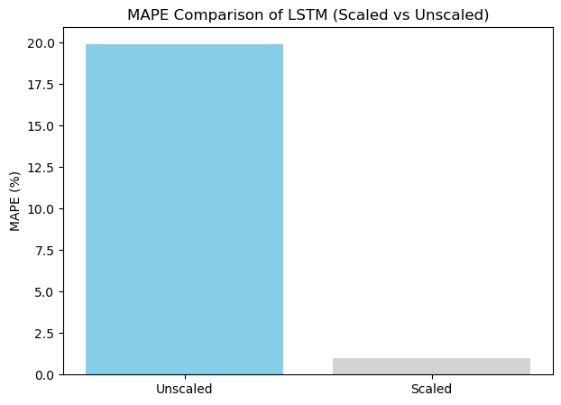
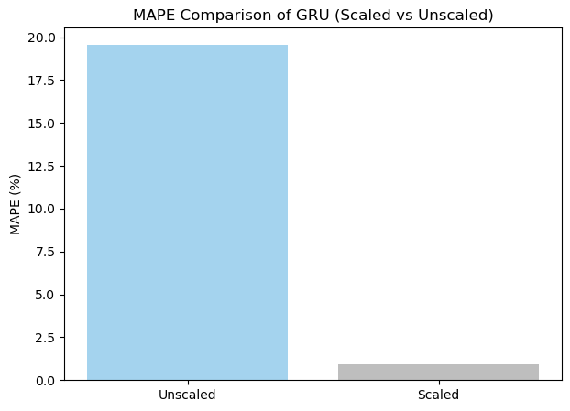
Test Result 1: Scaling Data for LSTM and GRU
Objective:
To test whether scaling the dataset improves the accuracy of the deep learning models.
Outcome:

Slide 14
Test Result 1: Scaling Data for LSTM and GRU
Outcome:
Scaled models perform better than Unscaled models as they have overall less MAPE value.
Unscaled Deep Learning models overfit the data.
Scaled models have MAPE of <1.5% which implies good predictions.

Slide 15
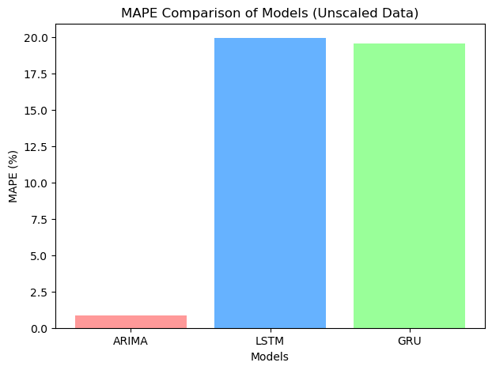
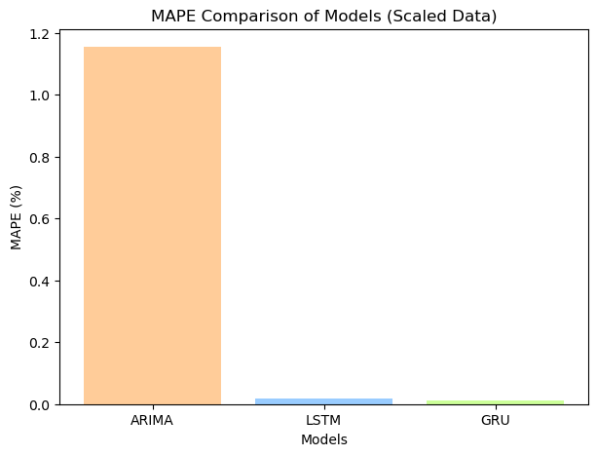
Test Result 2: Comparing ARIMA, LSTM, and GRU
Objective:
To compare the performance of traditional ARIMA with deep learning models (LSTM and GRU).
Outcome:

Slide 16
Test Result 2: Comparing ARIMA, LSTM, and GRU
Outcome:
LSTM , GRU perform better on Scaled dataset while overfitting on unscaled dataset.
ARIMA performs well on both the models.
Overall , DL models : LSTM and GRU with Scaled data perform the best.

Slide 17
Conclusion
Summary:
ARIMA worked well for capturing trends in the data and performed really well as the data was stationary.
LSTM and GRU showed better results on scaled data, especially for capturing non-linear patterns in stock prices but overfitted the unscaled data.
Scaling helped improve performance, but unscaled data still yielded competitive results.
Future Outlook:
Trying hybrid models (ARIMA + LSTM), further hyperparameter tuning to further improve accuracy.
Investigate external market factors and integrate them as features in future models.

Slide 18

Thank you

